Slide 4
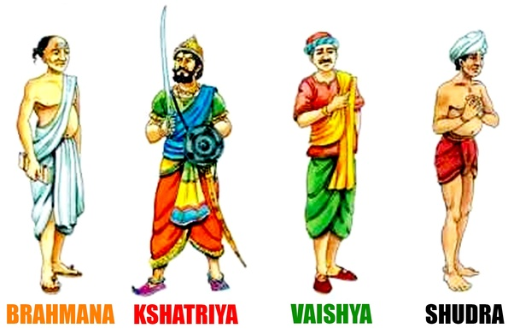

Slide 5
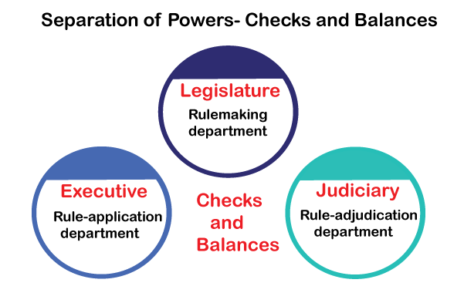

Slide 7
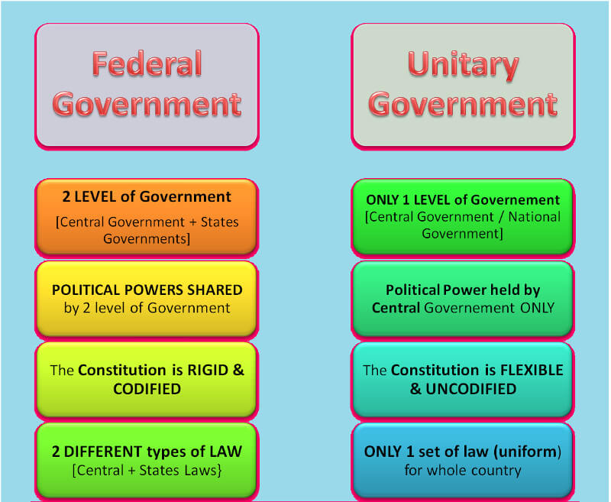

Slide 10
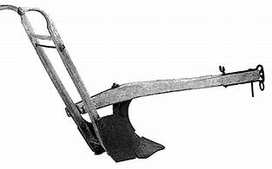
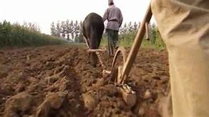
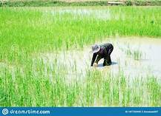
Production increased

Slide 11
Built roads and bridges
Encouraged trade
Sea route trade(silk, muslin, perfumes ,ivory)

Slide 12
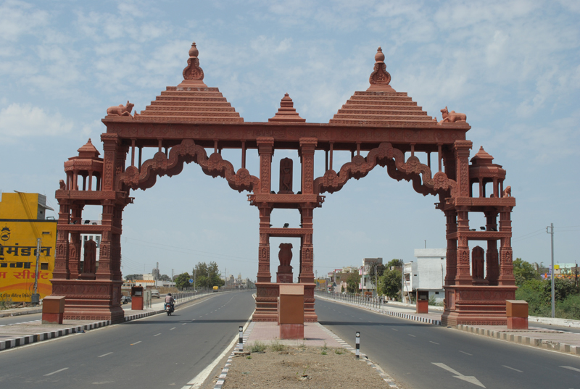
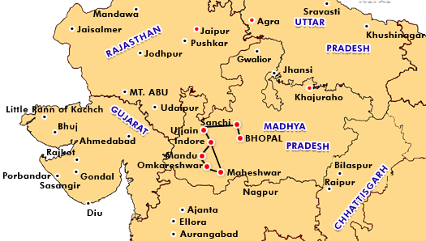
UJJAINI

Slide 13
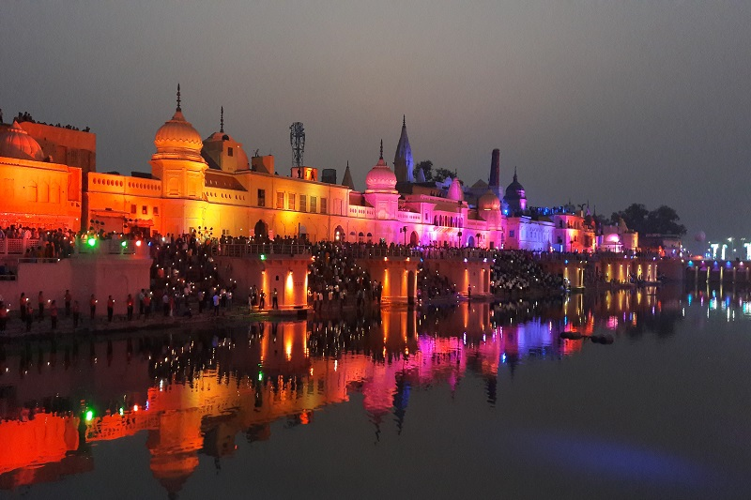
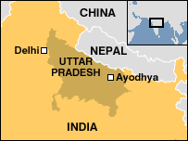
AYODHYA

Slide 15
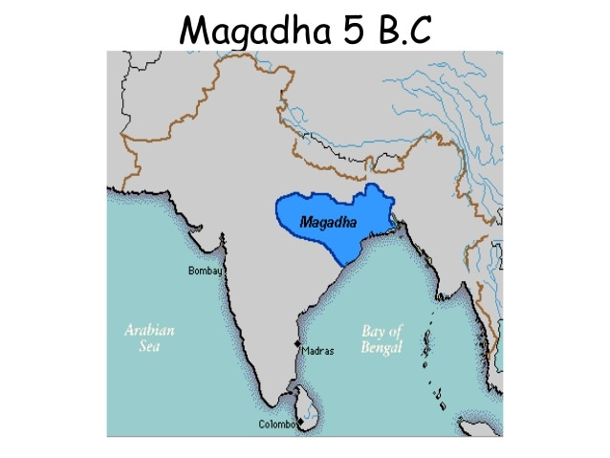
Deposits of iron ore
Nature protected Magadha
Located in Gangetic basin
Forests provid and
elephants
Deposits of iron ore
Nature protected Magadha
Flourishing trade
Powerful kings ruled Magadha.

Slide 16
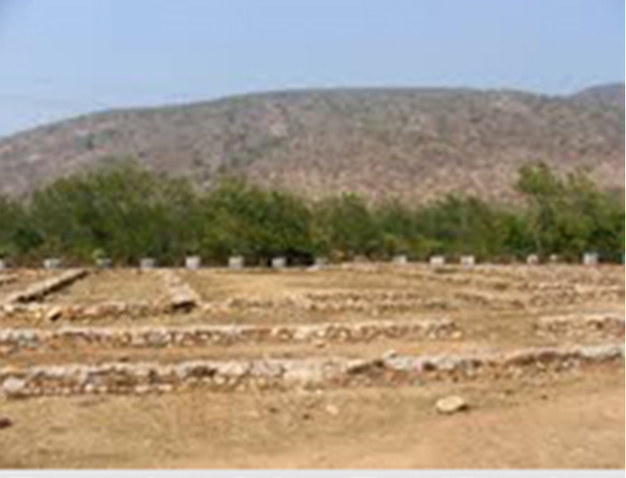
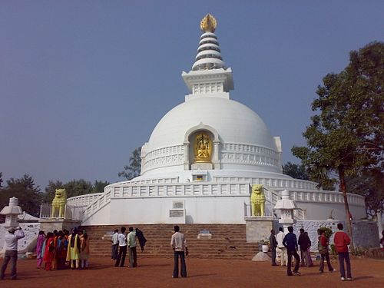
Old capital-Rajagriha

Slide 17
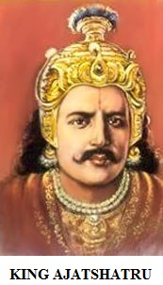

Slide 18
Vajji confederacy:
Lichchhavis
Ajathashatru conquered this mahajanapada

Slide 19
References:
https://www.youtube.com/watch?v=iDi-R4WVO8Q
https://www.youtube.com/watch?v=clSai3lpZ-I

